Slide 1
Augmented Reality with local feature
COMPUTER VISION – CS231.L12.KHCL
Instructor : Nguyễn Vinh Tiệp

Slide 2
TEAM 3
Table of content
Đặng Nguyễn Anh Tuấn -- 18521591
Đặng Hữu Toàn -- 18521503
Nguyễn Văn -- 18521632
What is augmented reality
Overview
Recognize the target surface
Feature detection/description
Feature matching
Homography Estimation RANSAC
2d
Create the Mask
3d
Projection matrix (3d)
Render model

Slide 3
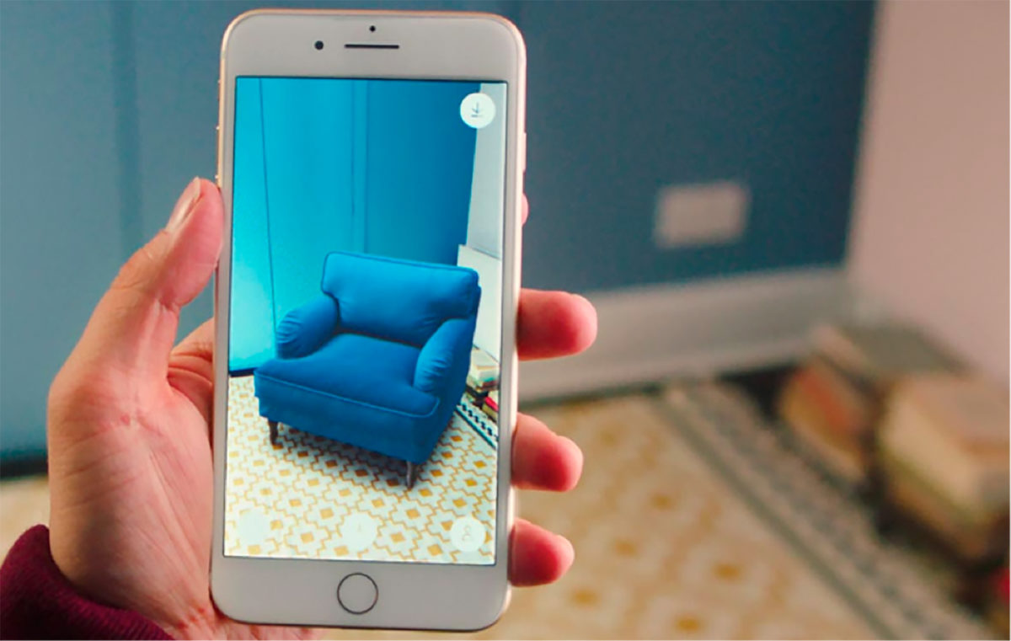
What is augment reality?
Augmented Reality (AR) is known as a technology allow human to observe, interact with virtual information (3D objects, video, image…) in real life through a electronic device

Slide 4
Overview Step
Identify the flat surface of reference in an image or video frame.
Use homography method to transform space.
Finally, project the 2d image or 3d model to the flat surface
Notes:
project in a screen a 3D model of a figure whose position and orientation matches the position and orientation of some predefined flat surface.
Furthermore, we want to do it in real time, so that if the surface changes its position or orientation the projected model does so accordingly.
To achieve this we first have to be able to identify the flat surface of reference in an image or video frame.
Once identified, we can easily determine the transformation from the reference surface image (2D) to the target image (2D). This transformation is called homography.
Finally, project the 2d image or 3d model to the flat surface

Slide 5

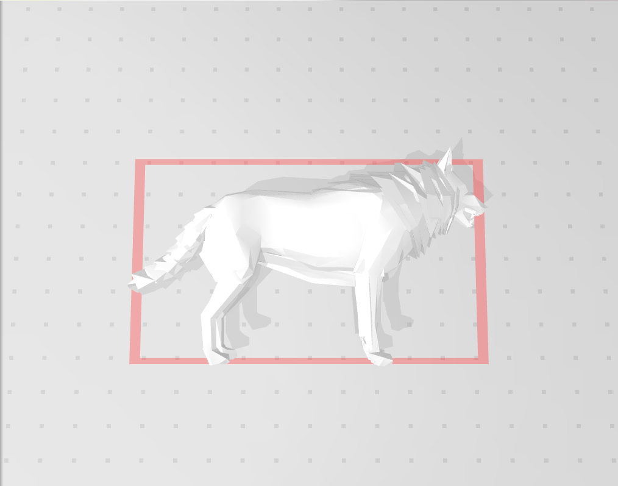

Material
3D model
Target image
Replace image (2D)
Notes:
Need image

Slide 6
Recognizing the target surface
This is a feature based recognition method, consist in three main steps:
feature detection/description
feature matching

Slide 7
Feature
The features can be classified into two main categories:
The features that are in specific locations of the images, These kinds of localized features are often called keypoint features (or even corners)
The features that can be matched based on their orientation and local appearance
Notes:
A feature is a piece of information which is relevant for solving the computational task related to a certain application. Features may be specific structures in the image such as points, edges or objects. Features may also be the result of a general neighborhood operation or feature detection applied to the image. The features can be classified into two main categories: The features that are in specific locations of the images, such as mountain peaks, building corners, doorways, or interestingly shaped patches of snow. These kinds of localized features are often called keypoint features (or even corners) and are often described by the appearance of patches of pixels surrounding the point location. The features that can be matched based on their orientation and local appearance (edge profiles) are called edges and they can also be good indicators of object boundaries and occlusion events in the image sequence.
Feature: là một phần thông tin có liên quan để giải quyết các nhiệm vụ tính toán liên quan đến một ứng dụng nhất định
1- đỉnh núi, góc xây dựng, cửa ra vào, hoặc các bản vá lỗi có hình dạng thú vị của tuyết ,thường được gọi là keypoint features
2 - được gọi là cạnh và chúng cũng có thể là về ranh giới đối tượng.

Slide 8
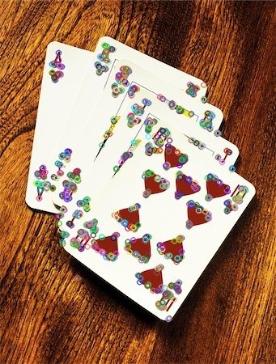
“uniqueness”

Slide 9
Feature detection
First, looking in both the reference in webcam and target images for features that stand out and describe part the object to be recognized.
This features can be later used to find the reference object in the target image
Notes:
Roughly speaking, this step consists in first looking in both the reference in webcam video and target images for features that stand out and, in some way, describe part the object to be recognized. This features can be later used to find the reference object in the target image.
We will assume we have found the object when a certain number of positive feature matches are found between the target and reference images.

Slide 10
Feature detection
For a region or point of an image to be labeled as feature it should fulfill two important properties:
first of all, it should present some uniqueness, this could be corners or edges.
Secondly, it should be invariant to transformations; i.e, invariant against scale, rotation or brightness changes.
Notes:
For a region or point of an image to be labeled as feature it should fulfill two important properties:
first of all, it should present some uniqueness at least locally. Good examples of this could be corners or edges.
Secondly, since we don’t know beforehand which will be, for example, the orientation, scale or brightness conditions of this same object in the image where we want to recognize it a feature should, ideally, be invariant to transformations; i.e, invariant against scale, rotation or brightness changes.

Slide 11

ORB (Oriented FAST and Rotated BRIEF)
ORB is basically a fusion of FAST keypoint detector and BRIEF descriptor with many modifications to enhance the performance.
The extracting features and its descriptors via the ORB detector function has already had in OpenCV, :orb.detectAndCompute
Notes:
Hình dạng và giá trị của bộ mô tả phụ thuộc vào thuật toán được sử dụng và trong trường hợp này, các bộ mô tả thu được sẽ là các chuỗi nhị phân.

Slide 12
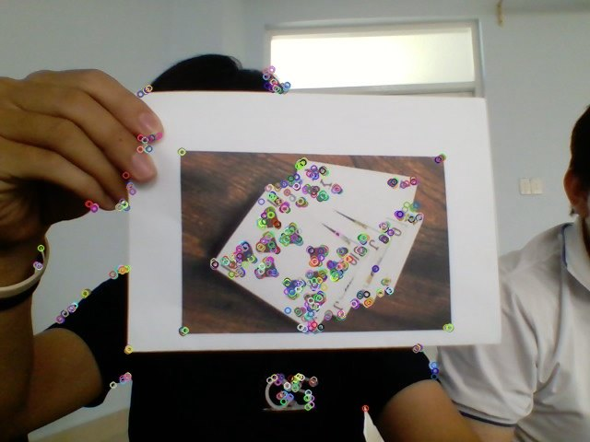
features detected from the surface of the target model
features detected from webcam scene.

Slide 13
Feature matching
Compute the distance from each feature in the first set to all the features in the second set
Then computing matches the other way around, from features in the second set to features in the first set.
This means that both features in both set must match each other.
. Once the matching has finished in both directions take the ones that fulfilled the condition only as the best match
Notes:
The simplest way of doing this is to take the descriptor of each feature in the first set, compute the distance to all the descriptors in the second set and return the closest one as the best match (I should state here that it is important to choose a way of measuring distances suitable with the descriptors being used. Since our descriptors will be binary strings we will use Hamming distance). This is a brute force approach, and more sophisticated methods exist.
For example, and this is what we will be also using, we could check that the match found as explained before is also the best match when computing matches the other way around, from features in the second set to features in the first set. This means that both features match each other. Once the matching has finished in both directions we will take as valid matches only the ones that fulfilled the previous condition

Slide 14
Feature matching
Finally, defined a threshold on the minimum number of matches that should be found.
If the number of matches is above the threshold, then assume the object has been found.
Otherwise there isn’t enough evidence to say that the recognition was successful.
Notes:
Finally, after matches have been found, we should define some criteria to decide if the object has been found or not. For this I defined a threshold on the minimum number of matches that should be found. If the number of matches is above the threshold, then we assume the object has been found. Otherwise we consider that there isn’t enough evidence to say that the recognition was successful.

Slide 15
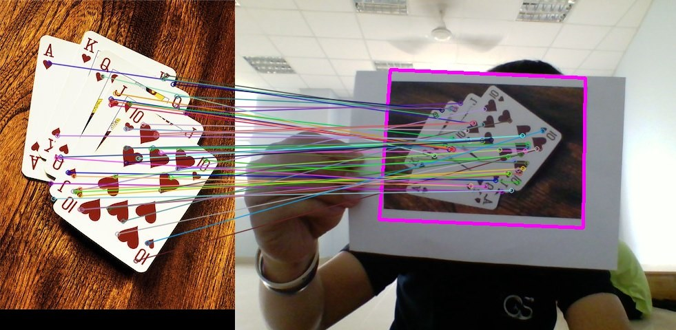
Feature matching

Slide 16
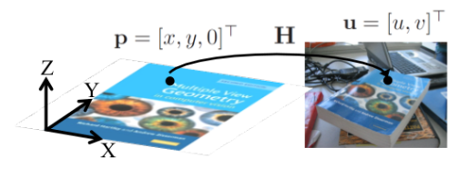
Homography
Notes:
Trong toán học, Homography là sự dịch chuyển sử dụng phép chiếu hình học, hay nói cách khác nó là sự kết hợp của cặp điểm trong phép chiếu phối cảnh. Ảnh thực trong không gian ba chiều có thể biến đổi về không gian ảnh bằng phép chiếu thông qua ma trận biến đổi Homography hay còn gọi là ma trận H. Các phép chiếu biến đổi thông qua ma trận Homography không đảm bảo về kích thước và góc của vật được chiếu, nhưng lại đảm bảo về tỉ lệ.

Slide 17
RANSAC
RANSAC - “RANdom SAmple Consensus”
Data
Inlier
outlier
Notes:
How can we find such a transformation? Since we have already found a set of matches between both images we can certainly find directly by any of the existing methods (I advance we will be using RANSAC) an homogeneous transformation that performs the mapping,
Ý tưởng của thuật toán là: Từ tập dữ liệu đầu vào có hai loại dữ liệu là “inlier” và “outlier”,
Trong đó, “inlier” là các dữ liệu không phải nhiễu và “outlier” là các dữ liệu nhiễu
Ta tiến hành tính toán và tìm ra mô hình tốt nhất cho tập dữ liệu. Việc tính toán và chọn ra mô hình tốt nhất sẽ được lặp đi lặp lại k lần, với giá trị k được chọn đủ lớn để đảm bảo rằng xác suất p (thường là 0,99) của tập dữ liệu mẫu ngẫu nhiên không chứa “outlier”.

Slide 18
RANSAC for homography estimation:
Randomly sample 4 matches
Estimate homography H
Verify homography. Search for matches consistent with H
Iterate until convergence
Notes:
Lặp lại k lần:
a. Chọn 4 cặp điểm tương đồng ngẫu nhiên.
b. Tính ma trận Homography Htmp từ 4 điểm.
c. Tính khoảng cách d của tập các cặp điểm tương đồng.
d. Tính số lượng m các cặp điểm inlier thỏa mãn điều kiện di < ngưỡng.
e. Nếu inlier > max_inlier thì max_inlier = inlier và ma trận Homograph H = Htmp y
w là tỉ lệ giữa số inlier trên tổng số điểm.
Thông thường chọn W = 50 %

Slide 19
2D
Detect boundary
Create warp image
Create mask
Inverse color
Use bitwise function

Slide 20
Masking step
Creating warp image
Creating a mask based on the location of the target found
Use the inverse method to find its negative
Add the mask inverse and the webcam image, it would become the a new image where all the webcam image information is shown except where the image is suppose to be augmented
Add replace image in the black area (empty space)
Notes:
remove the area in the webcam image where we want to overlay our target image and then add them together. This can be done using masking.
So first we are creating a mask based on the location of the target found. Now we can use the inverse method to find its negative. If we add the mask inverse and the webcam image we would get the anew image where all the webcam image information is shown except where the image is suppose to be augmented. So the black area can be thought of an empty space where we can add our image.
So once we have the imgAug which is our new masked image and the imgWarp, we can simply add them up using the bitwise Funtion

Slide 21
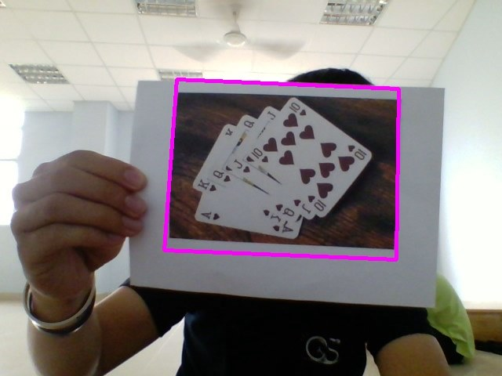
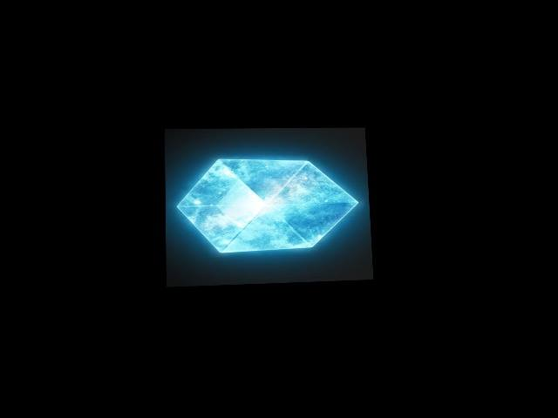
Warp image
boundary
Notes:
#create a replace img // paint the webcam background to black (0,0,0), then use homo border (img2)(the 4 card), replace the inside the border (the 4 card) to the replaced img (the cube)

Slide 22


Create mask
Inverse mask
(bitwise not)
Notes:
#making mask // paint all the mask to black (0)
#then find the homo border, use the position in the webcam, cover the border to the mask, then paint inside the that border in mask to white (1)
#inverse the color of the mask, black(0) to white(1) and the otherway around

Slide 23
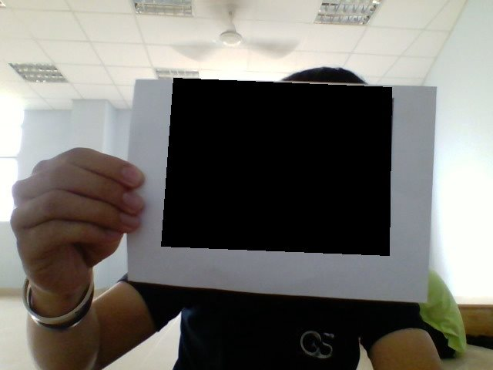
Bitwise and
Bitwise and
Inverse mask
Webcam
Notes:
# and: 1(mask--white back ground) * ~1(Webcam) = 1
# 0(mask—black boundary) * ~1(Webcam) = 0

Slide 24
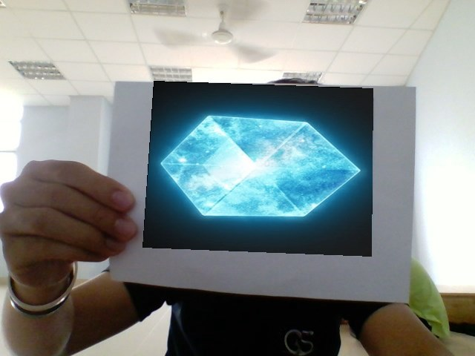
Bitwise or
Bitwise or
Bitwise and
Warp image
Notes:
#or: 0(the black of the warp) + ~1(bitwise and - background) = 1
# ~1(image of the warp) + ~1(bitwise and – blackmask ) = 1

Slide 25
3D
Calculate projection matrix
Render model

Slide 26
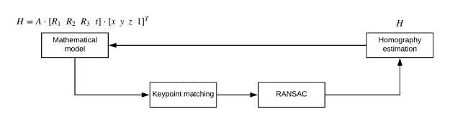
Projection Matrix

Slide 27

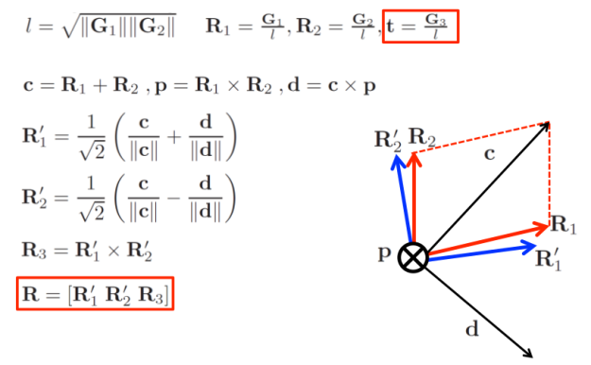
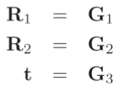
3D projection matrix = A · [R1′ R2′ R3 t]

Slide 28
Render Model
Using simple models in Wavefront .obj format. Why OBJ format?
Step1: Scale point
Step2: Locate point in 3D space
Step3: Coloring model (only one color)

Slide 29
Final:DEMO

Slide 30
Thank you for watching!!!!

